Slide 1
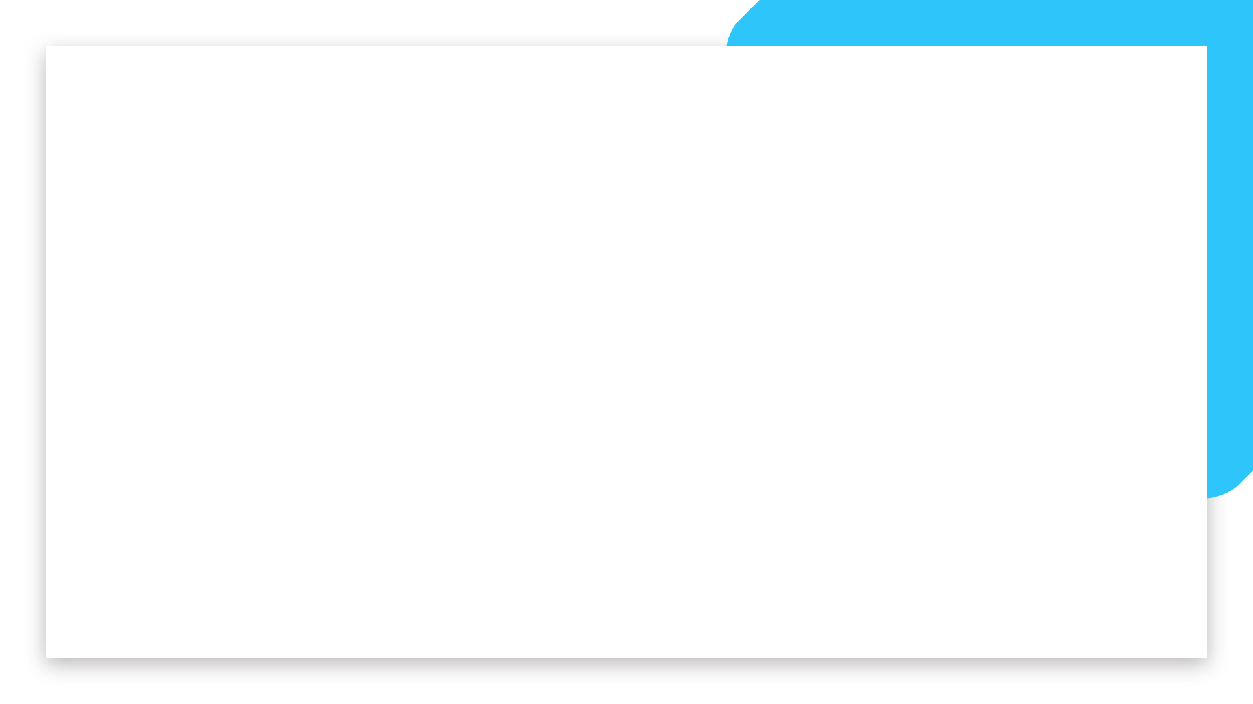


Data Science and Machine Learning
Generative AI Final

Slide 2
Generative AI & Large Language Models Final

Slide 3
MultiModal Concept

Slide 4
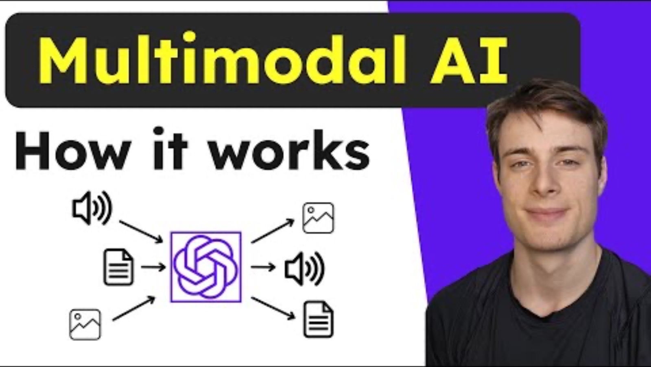
MultiModal Concept

Slide 5
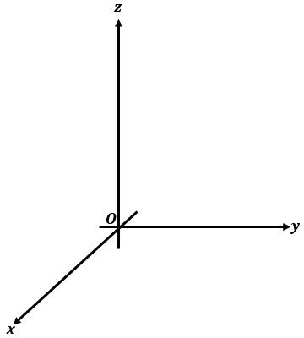







MultiModal Concept
fire
book
jumps
fox
swim
whale

Slide 6
Cloud Providers

Slide 7







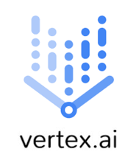



Cloud Providers
Cloud Providers

Slide 8
AZURE DEMO

